Slide 1
We will get started shortly.
International Science Nutrition Society – CURARE CAUSAM - ISNS 2023

Slide 2
ISNS CASE STUDY
With Dr. Norbert Ketskes on Bronchial Asthma
International Science Nutrition Society – CURARE CAUSAM - ISNS 2023

Slide 3
Medical Disclaimer
The information provided is for educational purposes and is not intended as medical advice, or a substitute for the medical advice of a physician or other qualified health care professional. This is for science and educational purposes only and cannot be used in any aspect for sales or marketing. You should not use this information for diagnosing a health or fitness problem or disease. You should always consult with a doctor or other health care professional for medical advice or information about diagnosis and treatment. This is Confidential. Do not distribute—for scientific educational purposes only.
International Science Nutrition Society – CURARE CAUSAM - ISNS 2023

Slide 5
DR. NORBERT KETSKÉS, MD
Dr. Norbert Ketskés M.D. is one the most acknowledged gastroenterologist in Hungary, specializing in natural and organic nutritional solutions, leading the well-known Primus Labor, a private clinic offering personalized nutritional advices to its patients.
Scientific Adviser of ISNS
Medical Partner of the Hungarian Olympic Committee since 2015
Member of the Medical board of Hungarian Karate Association since 2015
Leader of the Primus Labor Private Medical Clinic since 2013
Working as a Family Doctor 1999 – 2012
International Science Nutrition Society – CURARE CAUSAM - ISNS 2023

Slide 6
CSISZTU ZSUZSA
Television - Presenter, Anchor, Editor, Journalist and Sports Lawyer, Sport-diplomat
Spokesperson of the Giro d’Italia Grande Partenza, (Road-Cycling World -Tour Championship)
Spokesperson of the FINA (Swimming and Waters poets World Championship)
2022 Vice-President of the Hungarian Sports Journalists’ Association
Member of the Hungarian Olympic Committee Member of the Advisory Board of the Hungarian Olympic Academy
Newly Elected Vice-President of the International Sports Journalists Association, the first female ever in the field from her homeland, and third globally since 1924 (AIPS)
International Science Nutrition Society – CURARE CAUSAM - ISNS 2023

Slide 7
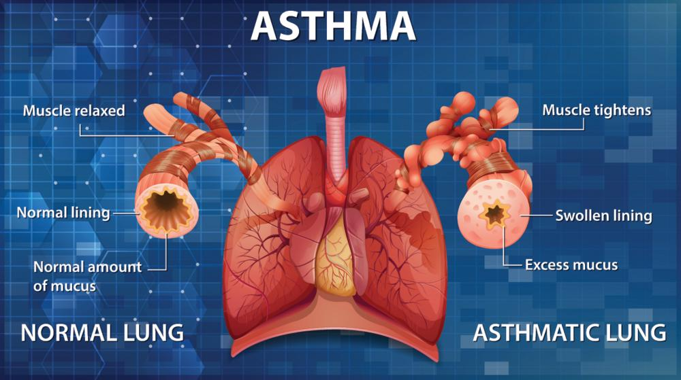
What is Asthma?
Asthma is a chronic lung disease affecting people of all ages. It affects the airways (the tubes that carry air in and out of the lungs). About 1 in 13 people in the United States has asthma, according to the CDC.
There is no cure for asthma, but treatment and an asthma action plan can help you manage it.
International Science Nutrition Society – CURARE CAUSAM - ISNS 2023

Slide 8
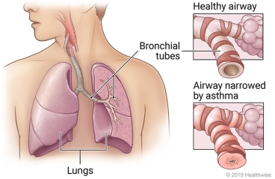
Asthma
When a person has asthma, airways are sensitive, and they can react to irritating things (or triggers) that are breathed in.
This reaction brings on inflammation, swelling and excess mucus in the airways, and tightening or smooth muscles that surround the airways.
With narrowed bronchi(bronchoconstriction), the flow of air is reduced, making it harder to breathe.
International Science Nutrition Society – CURARE CAUSAM - ISNS 2023

Slide 9
What Causes Symptoms of Asthma?
Researchers have identified the two main conditions that cause asthma symptoms: inflammation and airway constriction. While symptoms may vary in intensity, they tend to be worse at night or in the early morning.
Inflammation – with asthma, the inside walls of the airways are swollen or inflamed. This inflammation makes the air passages particularly sensitive to irritants and asthma triggers. The swelling narrow the air passages, making it difficult for air to pass through the airways. This makes it hard to breathe normally.
Airway constriction – when the airways come into contact with certain asthma triggers, the muscles around the airways tighten. This causes the air passages to become even narrower. It also causes you to have a tight feeling in your chest. Some say it feels like a rope is being tightened around your chest.
International Science Nutrition Society – CURARE CAUSAM - ISNS 2023

Slide 10
What are the symptoms of Asthma?
The symptoms of asthma can vary from person to person. Symptoms sometimes get significantly worse. This is known as an asthma attack. Symptoms are often worse at night or during exercise.
Common symptoms of asthma include:
A persistent cough, especially at night
Wheezing when exhaling and sometimes inhaling
Shortness of breath or difficulty breathing, sometimes even when resting
Chest tightness, making it difficult to breathe deeply
Some people will have worse symptoms when they have a cold or during changes in the weather. Other triggers can include dust, smoke, fumes, grass, and tree pollen, animal fur and feathers, strong soaps, and perfume.
International Science Nutrition Society – CURARE CAUSAM - ISNS 2023

Slide 11
Causes of Asthma
Many factors have been linked to an increased risk of developing asthma, although is often difficult to find a single, direct cause.
Asthma is more likely if other family members also have asthma – particularly a close relative, such as a parent or sibling.
Asthma is more likely in people who have other allergic conditions, such as eczema and rhinitis (hay fever).
Urbanization is associated with increased asthma prevalence, probably due to multiple lifestyle factors.
Events in early life affect the developing lungs and can increase the risk of asthma. These include low birth weight, prematurity, exposure to tobacco smoke and other sources of air pollution, as well as viral respiratory infections.
Exposure to a range of environmental allergens and irritants is also thought to increase the risk of asthma, including indoor and outdoor air pollution, house dust mites, molds, and occupational exposure to chemicals, fumes, or dust.
Children and adults who are overweight or obese are at a greater risk for developing asthma.
International Science Nutrition Society – CURARE CAUSAM - ISNS 2023

Slide 12
CASE STUDY
Patient: Female
Age: 35
History: Her father also has asthma
Medical history:
She has recurrent episodes of coughing, wheezing, chest tightness, and
shortness of breath.
She reports that these symptoms are often triggered by exposure to allergens, such as pet dander and pollen, as well as physical exertion.
An acute attack occurred every 2-3 days
She was diagnosed 6 months ago.
Clinical tests:
Pulmonary examination
Respiratory function tests:
e.g.: Tiff: 75% (The Tiffeneau index (FEV1/ VC %) is the most sensitive parameter of airway narrowing, whose value is over 80 percent in healthy adults.
International Science Nutrition Society – CURARE CAUSAM - ISNS 2023

Slide 13
Conventional Treatment
Asthma cannot be cured but there are several treatments available. The most common treatment is to use an inhaler, which delivers medication directly to the the lungs.
Inhalers can help control the disease and enable people with asthma to enjoy a normal, active life.
There are two main types of inhalers:
Bronchodilators (such as salbutamol), that open the air passages and relieve symptoms
Steroids (such as beclomethasone) reduce inflammation in the air passages, which improves asthma symptoms and reduces the risk of severe asthma attacks and death.
People with asthma may need to use their inhaler every day. Their treatment will depend on the frequency of symptoms and the types of inhalers available.
She received asthma education and learned how to monitor her symptoms and use her inhalers effectively.
Treatment:
Montelukast (montelukast)10mg
Foster (formoterol and beclometasone) 100/6 2x2 puffs
Berodual (ipratropium and fenoterol) if necessary 2x2 puffs (rescue medication)
International Science Nutrition Society – CURARE CAUSAM - ISNS 2023

Slide 14
Method
PROPRIETARY BLENDS LEGEND
Proprietary blend I: 2x5 drops, morning and evening, for 3 days, then every 3 days then increased by 1-1 drops every 3 days to 2x10
Proprietary blend II :1 in the morning for 7 days, then 1 in the morning and 1 in the afternoon
Proprietary blend III:1 sachet in the morning for 7 days then 1 sachet in the morning and 1 sachet in the evening
Proprietary blend IV: 1/2 teaspoon in the
morning
Proprietary blend VI: 1 in the
morning and 1 in the evening
Proprietary Blend I: Silica, Vitamin C, and Trace Minerals
Proprietary Blend II: N-acetyl L-tyrosine, anhydrous caffeine, L-theanine, Velvet Bean Seed, Pine Bark, Curcumin, and Vitamin D
Proprietary Blend III: Black Seed Oil, Resveratrol, Turmeric, Raspberry Ketone, Apple Cider Vinegar, Aloe Vera, and D-Ribose
Proprietary Blend IV: Vitamin C, Zinc Sulfate, and Vitamin D3
Proprietary Blend V: Inulin, Green Banana Flour, Apple Fiber, Bacillus Coagulans, Spirulina, Wheat Grass, Barley Grass, Alfalfa Leaf, Flax Seed, Psyllium Husk Powder, Chlorella, Broccoli, Kale, Spinach, Green Cabbage, Parsley, Aloe Vera, Cayenne Pepper, Blue berry Powder, Pomegranate Seed Powder, and MCT Coconut Oil Powder
Proprietary Blend VI: B-Nicotinamide Adenine Dinucleotide (NAD+), Magnesium, Trace Minerals, Quercetin, Vitamin D, Vitamin C, and Vitamin K2
Proprietary Blend VII: Hydrolyzed Bovine Collagen, Whole Bovine Colostrum Powder
International Science Nutrition Society – CURARE CAUSAM - ISNS 2023

Slide 15
Additional Treatment
Exercises to achieve a positive mental and emotional state
(e.g: Yoga, meditation, breathing exercises, stress management)
International Science Nutrition Society – CURARE CAUSAM - ISNS 2023

Slide 16
Results
After 1 month:
The intensity of symptoms has decreased.
(coughing, wheezing, chest tightness, and shortness of breath)
An acute attack occurred once a week.
After 2 months:
Her symptoms continued to improve significantly.
She had no acute attacks in the second month
She didn't need the emergency medicine!
She was able to participate in physical activities without significant limitations!
Control Respiratory function test:
Tiff: 89% (from 75%)
International Science Nutrition Society – CURARE CAUSAM - ISNS 2023

Slide 17
Research Studies
International Science Nutrition Society – CURARE CAUSAM - ISNS 2023

Slide 18
Evaluation of Efficacy of Curcumin as an Add-on therapy in Patients of Bronchial Asthma Afroz Abidi, Surabhi Gupta, Manu Agarwal, H.L Bhalla, and Mahip Slauja
Background: Bronchial asthma being a chronic inflammatory disease of airways has numerous treatment options none of which have disease modifying properties. Curcumin, a yellow dietary pigment has varied pharmacological activities, prominent among which is an anti-inflammatory activity which may be crucial in bronchial asthma as has been proved by various in vitro and in vivo animal studies.
Aims: To determine the efficacy and safety of curcumin as an ‘add-on’ therapy in patients of bronchial asthma.
Settings and Design: This study was conducted on 77 patients of mild to moderate Bronchial asthma who had a documented positive bronchodilator reversibility test with ≥15% improvement in forced expiratory volume one second (FEV1).
Results and Conclusion: The results showed that curcumin capsules help in improving the airway obstruction which was evident by significant improvement in the mean FEV1 values. There was also significant improvement in the hematological parameters and absence of any clinically significant adverse events indicates dependable safety profile of curcumin capsules, though there was no apparent clinical efficacy. Therefore, it is concluded that curcumin is effective and safe as an add-on therapy for the treatment of bronchial asthma.
https://www.ncbi.nlm.nih.gov/pmc/articles/PMC4190737/
International Science Nutrition Society – CURARE CAUSAM - ISNS 2023

Slide 19
Medicinal benefits of Nigella sativa in bronchial asthma: A Literature Review Abdulrahman Koshak, Emad Koshak, and Michael Heinrich
This review aimed to assess the studies supporting the medicinal use of NS in asthma and to highlight future research priorities. Various medical databases were searched for the effects of NS and its active secondary metabolites in asthma inflammation and outcomes.
There were fourteen preclinical studies describing multiple effects of NS in animal or cellular models of asthma including bronchodilation, anti-histaminic, anti-inflammatory, anti-leukotrienes and immunomodulatory effects. Furthermore, seven clinical studies showed improvements in different asthma outcomes including symptoms, pulmonary function and laboratory parameters.
This literature review showed that various preparations derived from Nigella sativa have a potential role for the clinical use in asthma. Preclinical studies of NS preparations showed bronchodilation, anti-histaminic, anti-inflammatory, anti-leukotrienes and immunomodulatory effects in animal or cellular models of asthma. Clinical studies of NS preparations showed an improvement of asthma symptoms control, lung function and asthma biomarkers.
https://www.ncbi.nlm.nih.gov/pmc/articles/PMC6111118/
International Science Nutrition Society – CURARE CAUSAM - ISNS 2023

Slide 20
References
https://www.who.int/news-room/fact-sheets/detail/asthma
https://www.nhlbi.nih.gov/health/asthma
https://www.ncbi.nlm.nih.gov/pmc/articles/PMC4190737/
https://www.ncbi.nlm.nih.gov/pmc/articles/PMC6111118/
International Science Nutrition Society – CURARE CAUSAM - ISNS 2023

Slide 21
Thank You for Joining Us This Week!!
International Science Nutrition Society – CURARE CAUSAM - ISNS 2023

